Slide 1
Chapter 5
Normalization
A major part of the notes were adapted from DATABASE DESIGN AND DEVELOPMENT: A VISUAL APPROACH Raymond Frost – John Day – Craig - Van Slyke Chapter 4: Normalization

Slide 2
Database Design - Recap
When we design a database, how do we know that the design is “correct”, i.e. it would not create problems when processing the database?
Is there a way to verify the correctness of the design?

Slide 3
Limitations of E-R Designs
ER Design
Provides a set of guidelines, does not result in a unique database schema
Does not provide a way of evaluating alternative schemas
Normalization theory provides a mechanism for analyzing and refining the schema produced by an E-R design

Slide 4
Normalization Theory
Result of E-R analysis need further refinement
Appropriate decomposition can solve problems
The underlying theory is referred to as normalization theory and is based on functional dependencies (and other kinds, like multivalued dependencies)

Slide 5
Database Tables and Normalization
Normalization
Process for evaluating and correcting table structures to minimize data redundancies
Usually involves dividing large tables into smaller (and less redundant) tables and defining relationships between them
helps eliminate data anomalies
Anomaly : something that deviates from what is standard, normal, or expected
i.e. when you update the data in the database, you EXPECT to get the correct result but SOMETIMES you DON’T
We should not have a database that gives INCORRECT result even if it only happens SOMETIMES – integrity problem
Works through a series of stages called normal forms:
First normal form (1NF)
Second normal form (2NF)
Third normal form (3NF)

Slide 6
Database Tables and Normalization (continued)
2NF is better than 1NF; 3NF is better than 2NF
For most business database design purposes, 3NF is highest we need to go in the normalization process
The other normal forms are Boyce-Codd NF,
4 NF, 5 NF and Domain Key NF

Slide 7
Normalization and Database Design (continued)
In the last chapter we use ERD to design database
ERD
Provides the big picture, or macro view, of an organization’s data requirements and operations
Top-down approach to database design
Created through an iterative process
Identifying relevant entities, their attributes and their relationship
Use results to identify additional entities and attributes

Slide 8
Normalization and Database Design (continued)
Normalization procedures
Focus on the characteristics of specific entities
A micro view of the entities within the ER diagram
Bottom-up approach to database design
Difficult to separate normalization process from ER modeling process
Two techniques should be used concurrently

Slide 9
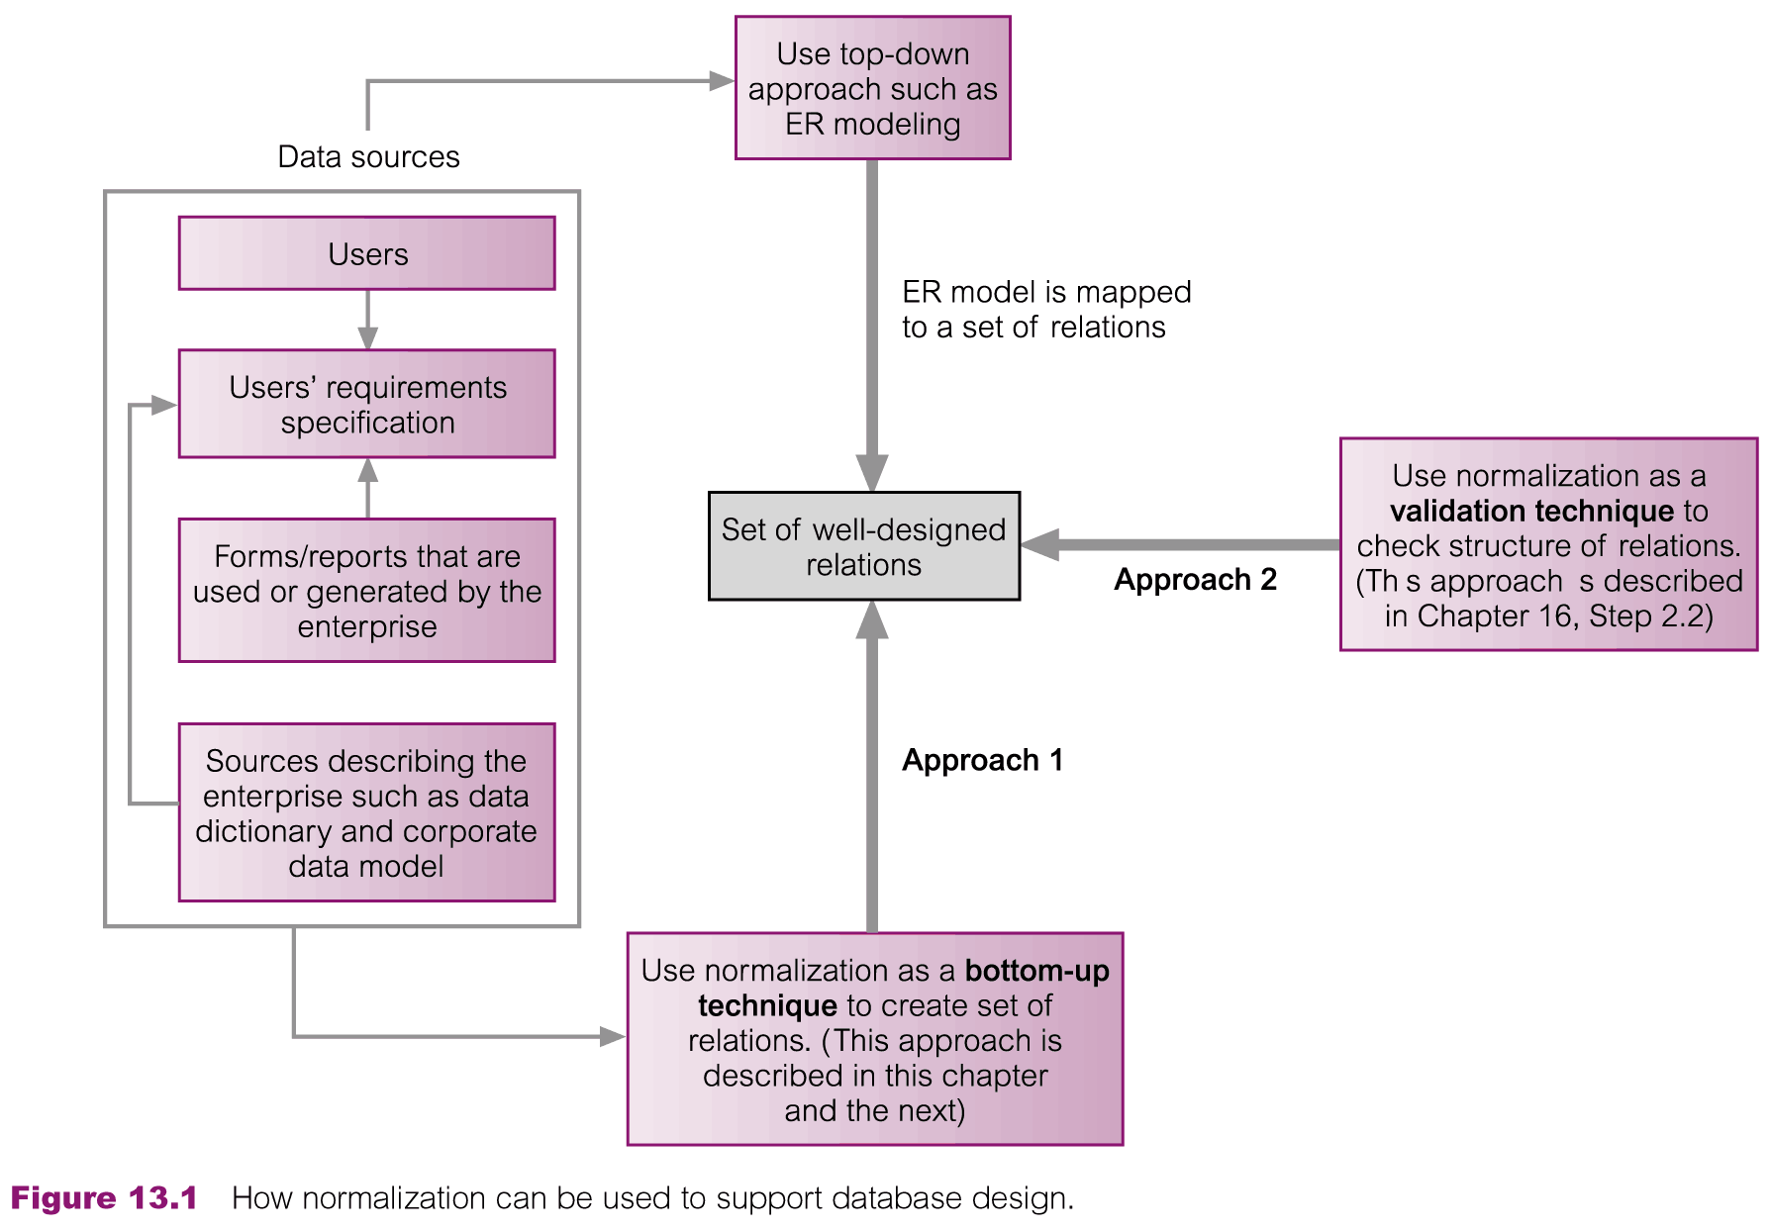
How Normalization Supports Database Design

Slide 10
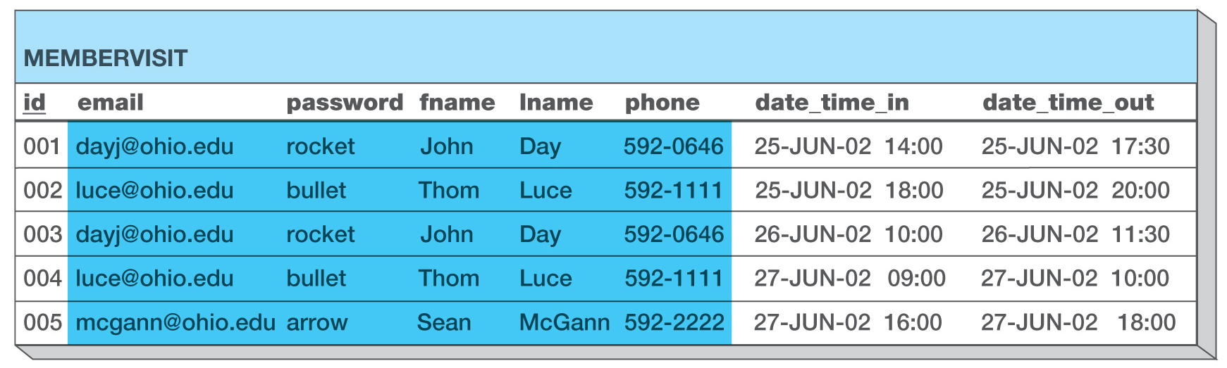
Unnormalized Sample Data
Case Scenario:
A cyber café wants to capture data about its members
A log book is used to record down the following:
Entry No, Member email, password, name, phone, IN time and OUT time
An example of a logbook entry
Entry no
*note the duplicate entries

Slide 11
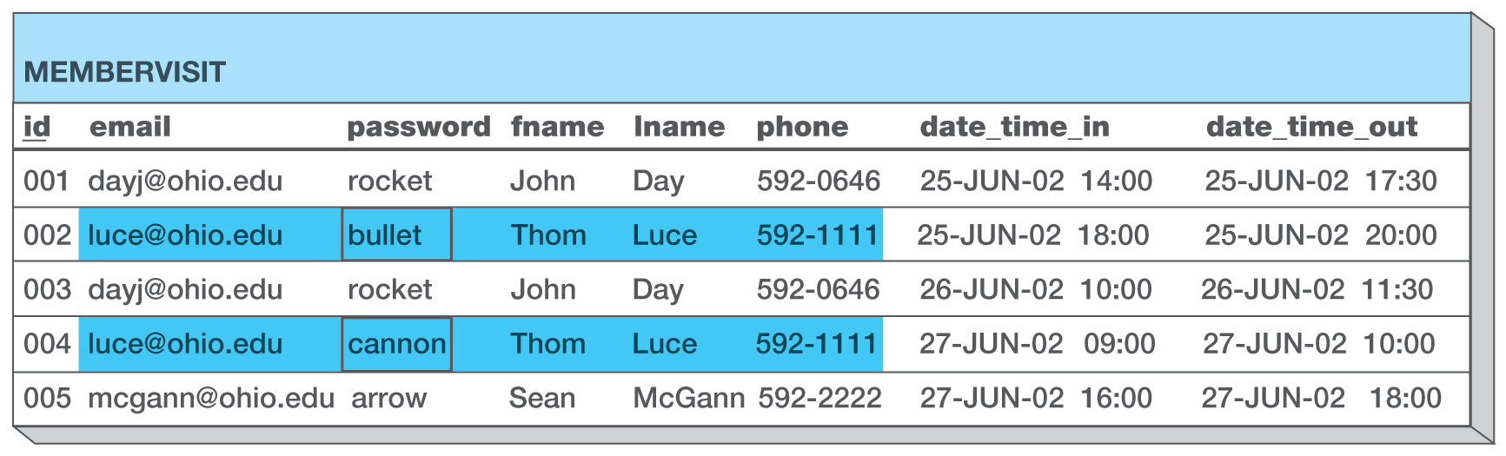
Unnormalized Design Causes Update Problems
When the password for Thom Luce was changed, it was not changed in both his entries.
Which password is the correct password?
Exhibit 4-3: Arcade Database Update Problems
Due to Duplicate Data

Slide 12
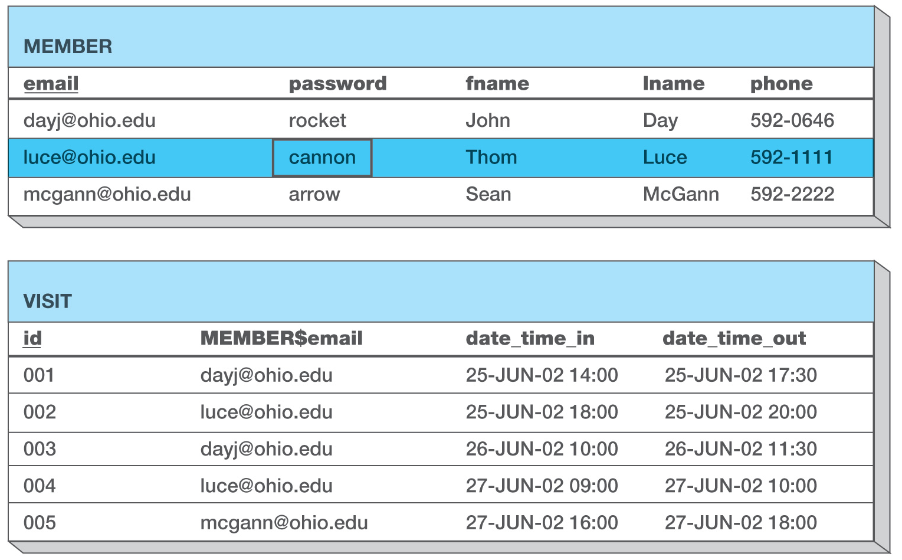
Normalized Design Eliminates Update Problems
If the database was normalized properly, there would only be one update done to the password, and the password would only appear in one place.
Exhibit 4-4: Arcade Database No Update Problem
in Normalized Data

Slide 13
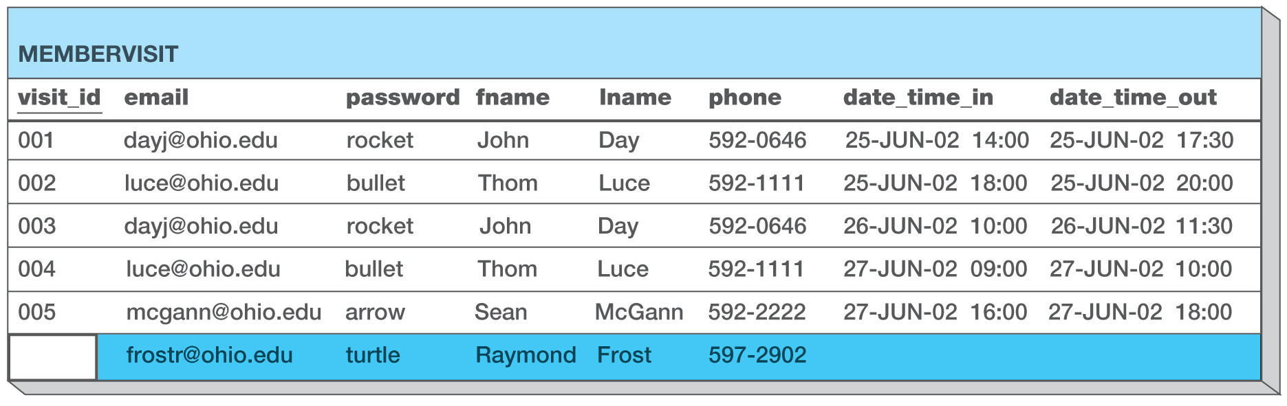
Unnormalized Design Creates Insert Problems
A new member cannot be created unless they have already made a visit, otherwise there would be no primary key value. This field may not be left blank.
Exhibit 4-5: Arcade Database Insert Problem
Due to Duplicate Data

Slide 14
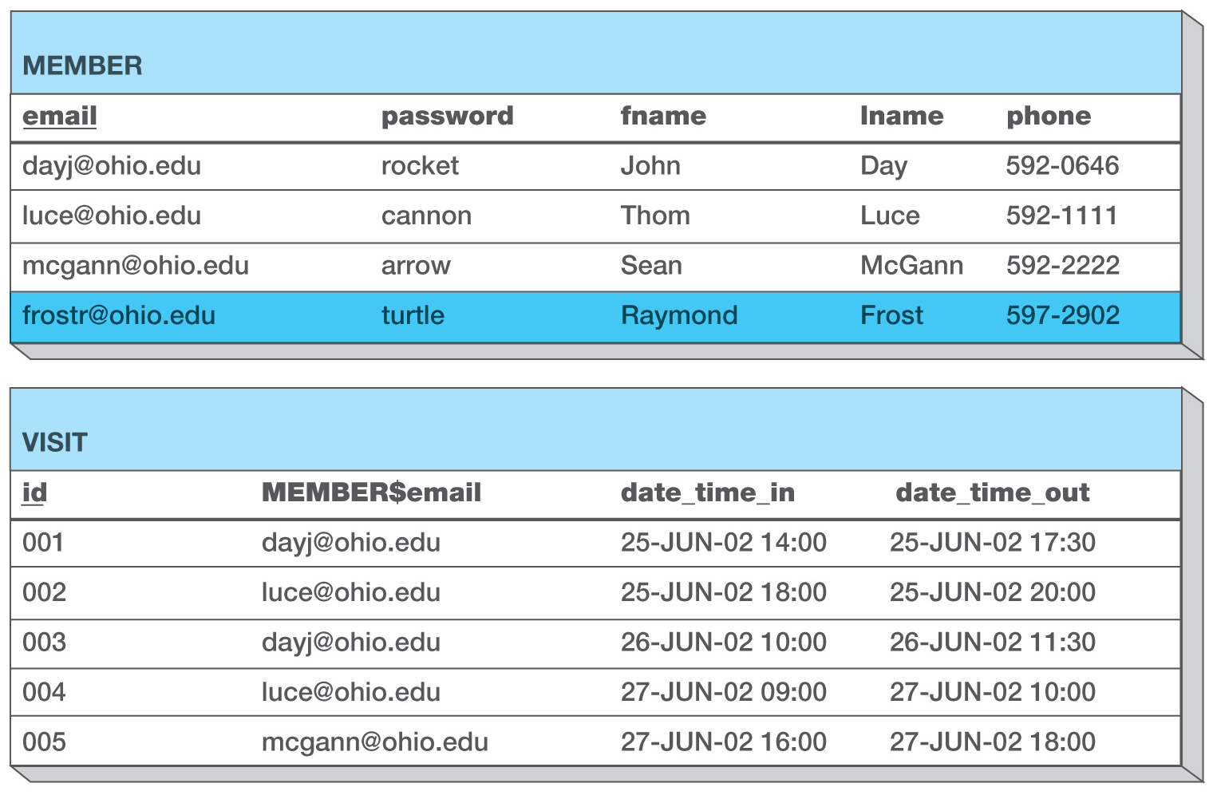
Normalized Design Eliminates the Insert Problem
In a normalized database , the addition of Raymond Frost as a new member is separate from the logging of his visits.
Exhibit 4-6: Arcade Database No Insert Problem
in Normalized Design

Slide 15
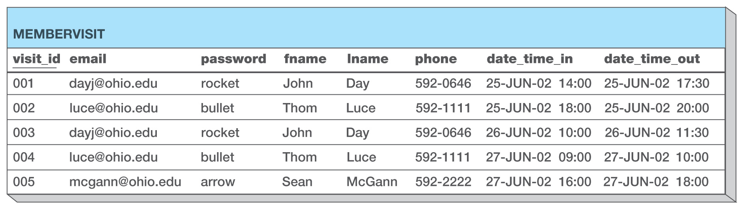
Unnormalized Design Creates Delete Problems
If a member makes only one visit, deleting that record will cause the loss of the member data.
For example, there is only one record to indicate Sean McGann’s member data.
If we had to delete record 005 (lets say we got the date wrong), then we would lose all of Sean’s data.
Exhibit 4-7: Arcade Database Delete Problem
Due to Duplicate Data

Slide 16
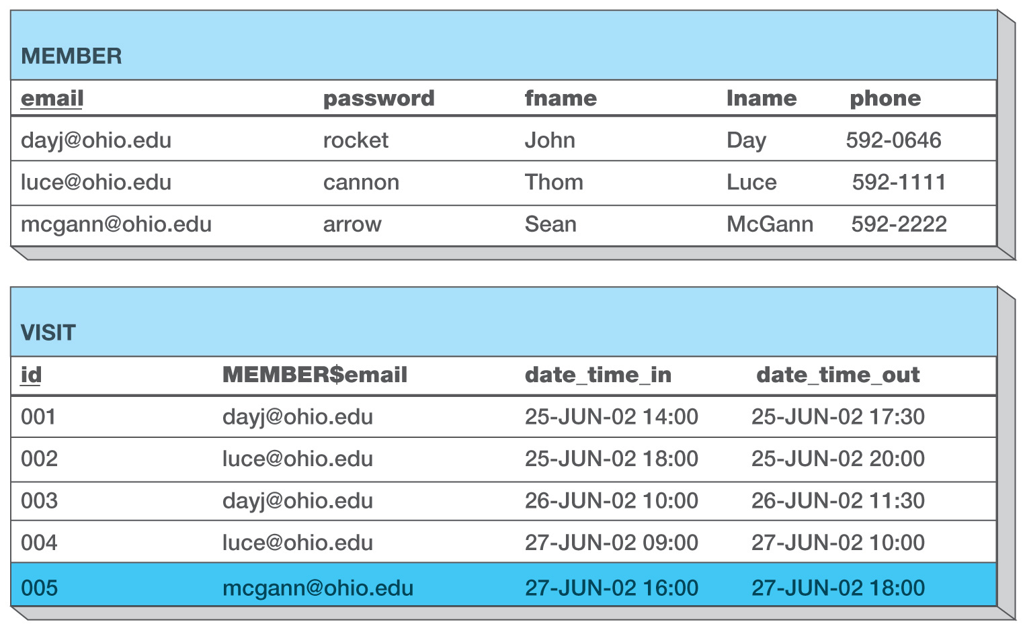
Normalized Design Eliminates the Delete Problem
Now, deleting visit 005 would not cause the loss of Sean McGann’s member data because his visitation data is separate from his member data.
Exhibit 4-8: Arcade Database No Delete Problem
in Normalized Design

Slide 17
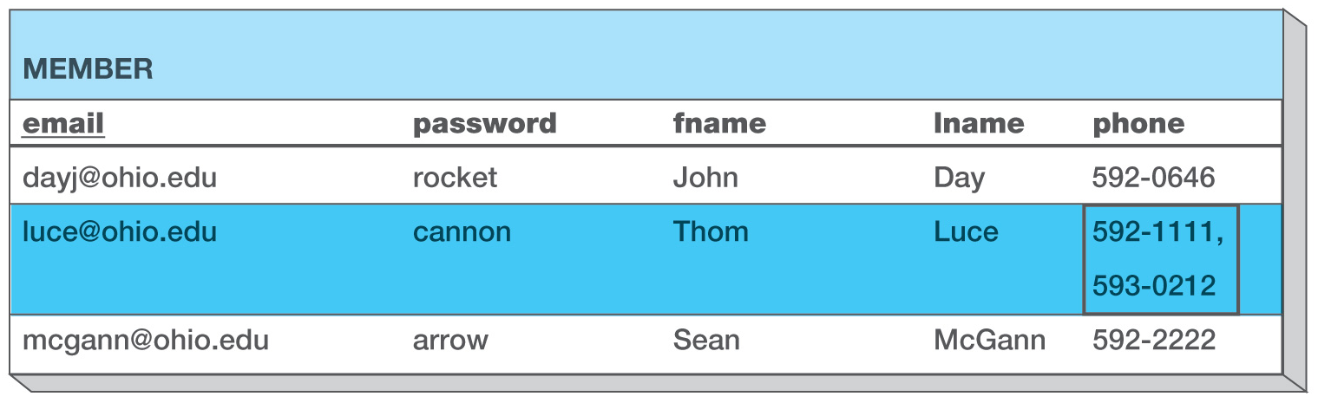
First Normal Form (1NF)
1N: A table in which all fields contain a single value.
Lets assume that a member can have more than one phone number. The example above would be a violation of the 1NF rule; therefore this table would have to be redesigned.
Exhibit 4-9: 1NF Violation

Slide 18
Fixing Normalization Violations
Step 1: Tables
Create new table(s)
Rename original table if necessary
Step 2: Relationships
Establish relationships between original and new table(s)
Step 3: Fields
Transfer fields and rename as needed
Step 4: Keys
Choose PK and FK for all tables
(PK and FK keys will be discussed in more details in a few slides later)

Slide 19
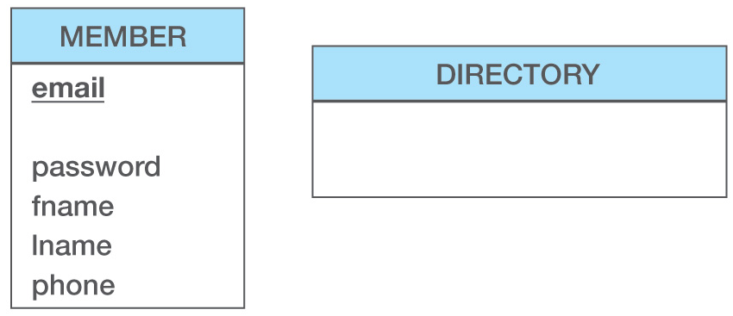
Solving a 1NF Violation
Step 1: Tables
Since the phone number column violated the 1NF rule, make a new table to hold phone numbers: DIRECTORY.
Exhibit 4-10: Arcade Database Solving
the 1NF Violation

Slide 20
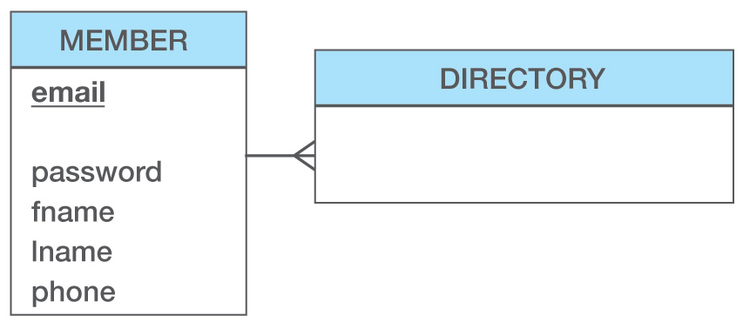
Solving a 1NF Violation
Step 2: Relationships
- A member has multiple phone numbers and a phone number belongs to one member
Exhibit 4-10: Arcade Database Solving
the 1NF Violation

Slide 21
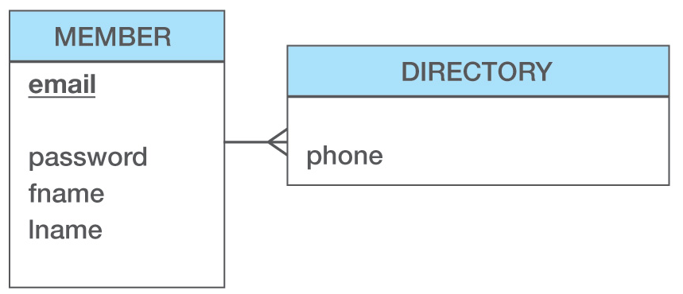
Solving a 1NF Violation
Step 3: Fields
- The phone field is transferred to the DIRECTORY table
Exhibit 4-10: Arcade Database Solving
the 1NF Violation

Slide 22
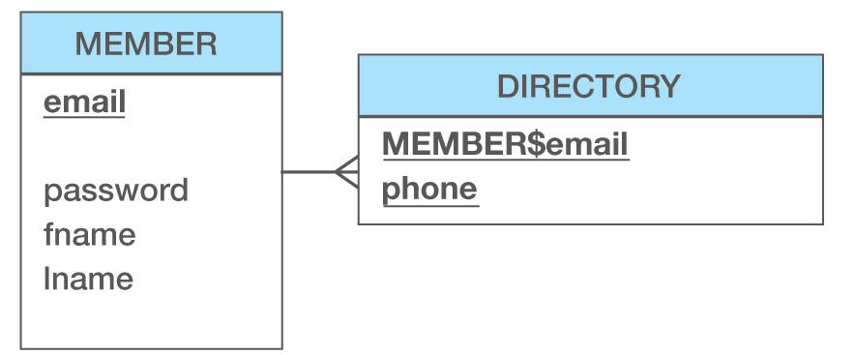
Solving a 1NF Violation
Step 4: Keys
(keys will be discussed in more details in a few slides later)
The email column in MEMBER becomes a FK (MEMBER$email) in DIRECTORY
The PK in DIRECTORY becomes MEMBER$email and phone since two members could have the same phone number
(e.g. two members from the same household).
Exhibit 4-10: Arcade Database Solving
the 1NF Violation

Slide 23
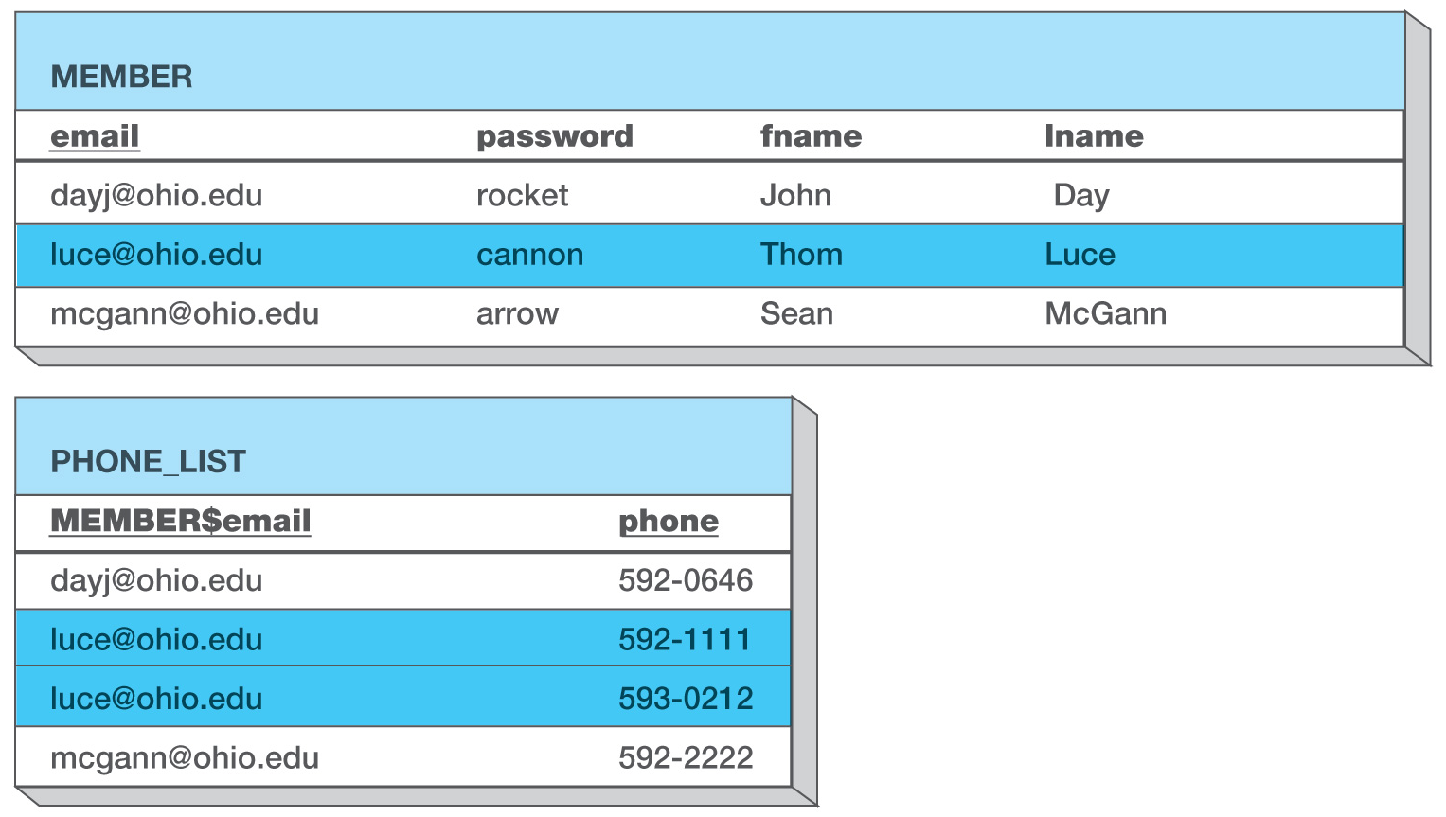
Tables in 1NF Eliminate Repeating Data Problems
Now all tables have fields that contain only single values.
Exhibit 4-11: 1NF Solution with Sample Data

Slide 24
Determinants
An important concept in Normalization is something called a determinant.
Determinant: a field or group of fields that controls or determines the values in another field.
From the previous example, the value of email will determine the values in all the other fields.
That is, if you know someone’s email, you can determine the rest of their information.
Stated another way, given an email, you will be able to find/retrieve the [EXACTLY ONE] member’s name, phone, etc.
A determinant MUST return only ONE value
Given the StudentID ‘ABC123456’, how many [Name, DOB, IC-No] will you retrieve?
Given the Name ‘Lim Ah Kau’, how many [StudentID, DOB, IC-No] will you retrieve?
Which is the determinant : StudentID or Name ?

Slide 25
Functional Dependency
Determinants are based on the concepts of functional dependency
A functional dependency occurs when the value of one (set of) attribute(s) determines (arrow symbol) the value of a second (set of) attribute(s):
StudentID → StudentName (i.e. One studentID will return one name)
StudentID → (DormName, DormRoom, Fee)
(i.e. One studentID will return one dorm name, one dorm room no and one fee)
The attribute on the left side of the functional dependency is called the determinant.
Functional dependencies may be based on equations:
ExtendedPrice = Quantity X UnitPrice
(Quantity, UnitPrice) → ExtendedPrice
Functional dependencies are not equations!

Slide 26
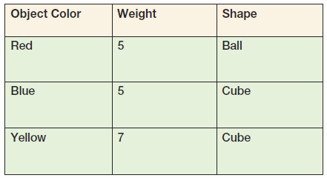
Functional Dependencies Are Not Equations
ObjectColor → Weight
ObjectColor → Shape
ObjectColor → (Weight, Shape)

Slide 27
Composite Determinants
Composite determinant = a determinant of a functional dependency that consists of more than one attribute
(StudentID, CourseCode) → (Grade)
StudentName | CourseCode | Grade
ABC1234 | AACS3013 | A
ABC1234 | AACS2373 | A
ABC1234 | AACS1234 | B
ABC4567 | AACS3013 | B+
ABC4567 | AACS2373 | A-
ABC4567 | AACS1234 | A
Not unique
Each combination is unique

Slide 28
Functional Dependency Rules
If A → (B, C), then A → B and A→ C.
If (A,B) → C, then neither A nor B determines C by itself.
ObjectColor → (Weight, Shape)
ObjectColor → Weight
ObjectColor → Shape
(StudentID, CourseCode) → (Grade)
(StudentID) → (Grade) NOT TRUE
(CourseCode) → (Grade) NOT TRUE

Slide 29
What Makes Determinant Values Unique?
A determinant is unique in a relation if and only if, it determines every other column in the relation.
You cannot find the determinants of all functional dependencies simply by looking for unique values in ONE column:
Data set limitations
Combination of columns may create a unique determinant
Must be logically a determinant
Make sense; according to business rules

Slide 30
Relational Database and Keys
In relational database design, the concept of KEYS are very important
A key is a combination of one or more columns that is used to identify rows in a relation.
A given key value will only identify one row of data
A composite key is a key that consists of two or more columns.
A Key is a determinant

Slide 31
Candidate and Primary Keys
A candidate key is a key that determines all of the other columns in a relation.
There can be more than one candidate key
E.g. StudentID, IC_No, Driving_License_No as a row in a table
A primary key is a candidate key selected as the primary means of identifying rows in a relation.
There is only ONE primary key per relation.
E.g. StudentID selected as the primary key
The primary key may be a composite key.
The ideal primary key is short, numeric, and never changes.

Slide 32
Surrogate Keys
A surrogate key is an artificial column added to a relation to serve as a primary key.
DBMS supplied
Short, numeric, and never changes—an ideal primary key
Has artificial values that are meaningless to users
Just a number to distinguish one record from another
Record ‘1001’ compared to record ‘1100’
Normally hidden in forms and reports
Reasons for using (refer additional pdf reading material)
Sometimes the combination of natural keys may be too large to use effeciently
E.g. Lets say a STAFF entity has a composite PK consisting of:
(Name, Address, DOB, Phone) → Salary
May be more efficient to just create another attribute call Staff_No (DBMS will auto generate and maintain a running number) to identify a staff record

Slide 33
Foreign Keys
A foreign key is the primary key of one relation that is placed in another relation to form a link between the relations.
A foreign key can be a single column or a composite key.
The term refers to the fact that key values are foreign to the relation in which they appear as foreign key values.
Example
DEPARTMENT (DepartmentName, BudgetCode, ManagerName)
EMPLOYEE (EmployeeNumber, EmployeeLastName, EmployeeFirstName,
DepartmentName*)
The values of the DepartmentName in the EMPLOYEE table comes from the primary key of the DEPARTMENT table.

Slide 34
The Referential Integrity Constraint
A referential integrity constraint is a statement that limits the values of the foreign key to those already existing as primary key values in the corresponding relation.
E.g.
CREATE TABLE TITLEAUTHOR (
au_id VARCHAR(11) NOT NULL,
title_id VARCHAR(6) NOT NULL,
au_ord NUMBER(1),
royaltyper NUMBER(3),
Primary key (au_id,title_id),
Foreign Key (au_id) References AUTHORS(au_id),
Foreign Key (title_id) References TITLES(title_id)
);
The values of au_id and title_id in the TITLEAUTHOR table must be from

Slide 35
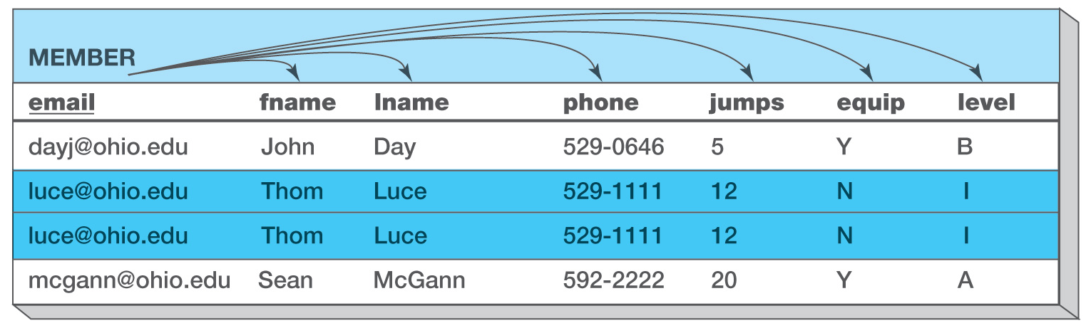
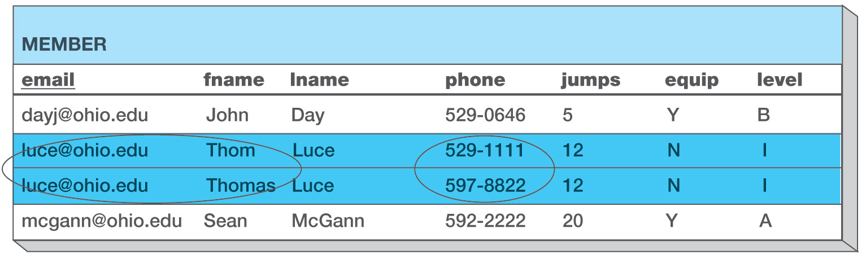
Determinants and Duplicate Data
When you have duplicate data, knowing someone’s email may not allow you to determine the rest of the data as shown below.
Exhibit 4-13: Email Acts as a Determinant
In this example, the duplicated email luce@ohio.edu will still return only one value for fname, lname, phone, etc
Exhibit 4-14: Email Fails to Act as a Determinant
In this example, the duplicated email luce@ohio.edu will return two different values for phone , therefore email is not a determinant

Slide 36
Another Example
Order Log
Customer No | Name | Tel No | Order No | Order Date | Item No | Description | Order Qty | Unit Price
A101 | Ali bin Ahmad | 1234567 | C1001 | 12/5/14 | K123 | Blue Pen | 5 | 2.50
 |  |  |  |  | M345 | Stainless steel ruler | 3 | 7.80
 |  |  |  |  | P876 | Mars Bars | 20 | 1.25
A102 | Lim Ah Kau | 1122448 | C1002 | 13/5/14 | K124 | Black Pen | 12 | 2.50
 |  |  |  |  | K325 | Marker Pen | 24 | 1.90
A101 | Ali bin Ahmad | 1234567 | C1003 | 15/5/14 | K123 | Blue Pen | 10 | 2.50
 |  |  |  |  | M345 | Stainless steel ruler | 6 | 7.80
 |  |  |  |  | P876 | Mars Bars | 25 | 1.25
An example of an Order Log, where each customer can make orders.
Each order can have many items.
An item can appear in more than one order.
Order Log is not in 1st NF because some of its columns contains multiple values: i.e. multiple values for ItemNo, Description, OrderQty and UnitPrice for each Order

Slide 37
Normalization Process - First Normal Form (1NF)
1NF rules:
No multivalued attributes
Every attribute value is atomic – single value only
Transform the OrderLog to 1NF
Step 1: Tables
Create new table(s)
Rename original table if necessary
Make a new table to hold all the column with multiple values:
Two tables required:
Orders table to hold data about orders by each customer
OrderItems table to hold data about items in each order
Orders
CustomerNo
Name
TelNo
OrderNo
OrderDate
ItemNo
Description
OrderQty
UnitPrice
OrderItems
© 2011 Pearson Education, Inc. Publishing as Prentice Hall

Slide 38
Normalization Process - First Normal Form (1NF)
Transform the OrderLog to 1NF
Step 1: Tables
Create new table(s)
Rename original table if necessary
Step 2: Relationships
Establish relationships between original and new table(s)
An order can have multiple items
Each item in the OrderItems table belongs to one Order
Step 3: Fields
Transfer fields and rename as needed
Step 4: Keys
Choose PK and FK for all tables
Orders
CustomerNo
Name
TelNo
OrderNo
OrderDate
ItemNo
Description
OrderQty
UnitPrice
OrderItems

Slide 39
Normalization Process - First Normal Form (1NF)
Transform the OrderLog to 1NF
Step 1: Tables
Create new table(s)
Rename original table if necessary
Step 2: Relationships
Establish relationships between original and new table(s)
Step 3: Fields
Transfer fields and rename as needed
All the fields with multiple values transferred to the OrderItems table
Step 4: Keys
Choose PK and FK for all tables
Orders
CustomerNo
Name
TelNo
OrderNo
OrderDate
OrderItems
ItemNo
Description
OrderQty
UnitPrice

Slide 40
Normalization Process - First Normal Form (1NF)
Transform the OrderLog to 1NF
Step 1: Tables
Create new table(s)
Rename original table if necessary
Step 2: Relationships
Establish relationships between original and new
Step 3: Fields
Transfer fields and rename as needed
Step 4: Keys
Choose PK and FK for all tables
Orders
CustomerNo
Name
TelNo
OrderNo
OrderDate
OrderItems
OrderNo*
ItemNo
Description
OrderQty
UnitPrice
Orders table
OrderNo → CustomerNo, Name, TelNo
OrderDate
i.e. Given an OrderNo (e.g. C1001), you will be able to retrieve a row of related data
OrderItems table
The PK (OrderNo) from the ORDERS table becomes a FK in the ORDERITEMS table to maintain a relationship between the two tables.
(OrderNo,ItemNo) → Description, OrderQty, UnitPrice
The combination of OrderNo and ItemNo will return a row of related data

Slide 41
Normalization Process - First Normal Form (1NF)
Step 4: Keys
Choose PK and FK for all tables
Order No | Customer No | Name | Tel No | Order Date
C1001 | A101 | Ali bin Ahmad | 1234567 | 12/5/14
C1002 | A102 | Lim Ah Kau | 1122448 | 13/5/14
C1003 | A101 | Ali bin Ahmad | 1234567 | 15/5/14
Orders table
OrderNo → CustomerNo, Name, TelNo
OrderDate
i.e. Given an OrderNo (e.g. C1001), you will be able to retrieve a row of related data
OrderItems table
(OrderNo,ItemNo) → Description, OrderQty, UnitPrice
The combination of OrderNo and ItemNo will return a row of related data
Order No | Item No | Description | Order Qty | Unit Price
C1001 | K123 | Blue Pen | 5 | 2.50
C1001 | M345 | Stainless steel ruler | 3 | 7.80
C1001 | P876 | Mars Bars | 20 | 1.25
C1002 | K124 | Black Pen | 12 | 2.50
C1002 | K325 | Marker Pen | 24 | 1.90
C1003 | K123 | Blue Pen | 10 | 2.50
C1003 | M345 | Stainless steel ruler | 6 | 7.80
C1003 | P876 | Mars Bars | 25 | 1.25

Slide 42
Normalization Process - First Normal Form (1NF)
At the end of the 1NF transformation, we now have two relations:
Orders (OrderNo, CustomerNo, Name, TelNo, OrderDate)
OrderItems(OrderNo,ItemNo, Description, OrderQty, UnitPrice)
Orders
Order No | Customer No | Name | Tel No | Order Date
C1001 | A101 | Ali bin Ahmad | 1234567 | 12/5/14
C1002 | A102 | Lim Ah Kau | 1122448 | 13/5/14
C1003 | A101 | Ali bin Ahmad | 1234567 | 15/5/14
OrderItems
Order No | Item No | Description | Order Qty | Unit Price
C1001 | K123 | Blue Pen | 5 | 2.50
C1001 | M345 | Stainless steel ruler | 3 | 7.80
C1001 | P876 | Mars Bars | 20 | 1.25
C1002 | K124 | Black Pen | 12 | 2.50
C1002 | K325 | Marker Pen | 24 | 1.90
C1003 | K123 | Blue Pen | 10 | 2.50
C1003 | M345 | Stainless steel ruler | 6 | 7.80
C1003 | P876 | Mars Bars | 25 | 1.25
Both the tables fulfill the 1NF requirements.
The table has a key
In every row, every column has only a single value

Slide 43
Second Normal Form (2NF) transformation
2NF: A table in which each non-key field is determined by the whole primary key and NOT part of the primary key by itself.
In the OrderItems relation, the composite key (OrderNo, ItemNo) will determine the OrderQty
OrderItems
Order No | Item No | Description | Order Qty | Unit Price
C1001 | K123 | Blue Pen | 5 | 2.50
C1001 | M345 | Stainless steel ruler | 3 | 7.80
C1001 | P876 | Mars Bars | 20 | 1.25
C1002 | K124 | Black Pen | 12 | 2.50
C1002 | K325 | Marker Pen | 24 | 1.90
C1003 | K123 | Blue Pen | 10 | 2.50
C1003 | M345 | Stainless steel ruler | 6 | 7.80
C1003 | P876 | Mars Bars | 25 | 1.25
OrderItems
OrderNo
ItemNo
Description
OrderQty
UnitPrice
Exhibit 4-15: 2NF Violation

Slide 44
Second Normal Form (2NF) transformation
If you know an ItemNo, you can determine its Description and UnitPrice.
Therefore, the Description and UnitPrice non-key fields are determined by just part of the primary key: ItemNo.
Description, UnitPrice are PARTIALLY dependent on (OrderNo,ItemNo)
Therefore, OrderItems is ONLY in 1NF not 2NF
OrderItems
OrderItems
OrderNo
ItemNo
Description
OrderQty
UnitPrice
Order No | Item No | Description | Order Qty | Unit Price
C1001 | K123 | Blue Pen | 5 | 2.50
C1001 | M345 | Stainless steel ruler | 3 | 7.80
C1001 | P876 | Mars Bars | 20 | 1.25
C1002 | K124 | Black Pen | 12 | 2.50
C1002 | K325 | Marker Pen | 24 | 1.90
C1003 | K123 | Blue Pen | 10 | 2.50
C1003 | M345 | Stainless steel ruler | 6 | 7.80
C1003 | P876 | Mars Bars | 25 | 1.25
Exhibit 4-15: 2NF Violation

Slide 45
Update Problem Caused by 2NF Violation
Order No | Item No | Description | Order Qty | Unit Price
C1001 | K123 | Blue Felt Pen | 5 | 2.50
C1001 | M345 | Stainless steel ruler | 3 | 7.80
C1001 | P876 | Mars Bars | 20 | 1.25
C1002 | K124 | Black Pen | 12 | 2.50
C1002 | K325 | Marker Pen | 24 | 1.90
C1003 | K123 | Blue Pen | 10 | 2.50
C1003 | M345 | Stainless steel ruler | 6 | 7.80
C1003 | P876 | Mars Bars | 25 | 1.25
The above table is ONLY in 1NF, it violates the 2NF rules. Data not determined by the whole primary key will be duplicated and any updates may not be made to all instances of duplicate data. (Update Anomaly)
In this example, we no longer know the correct description for ItemNo ‘K123’.
Do you think a relation in 1NF have Insertion Anomaly? Deletion Anomaly?
Exhibit 4-16: 2NF Violation Creates Update
Problem

Slide 46
Solving a 2NF Violation
Step 1: Tables
OrderItems
OrderNo
ItemNo
ItemNo
Description
OrderQty
UnitPrice
Since only OrderQty belongs in the ORDERITEMS table, create a new table (ITEMS) for the item information.
Items
Step 2: Relationships
Step 3: Fields
Step 4: Keys

Slide 47
Solving a 2NF Violation
Step 1: Tables
Since only OrderQty belongs in the ORDERITEMS table, create a new table (ITEMS) for the item information.
Step 2: Relationships
- An ITEMS can appear in many ORDERITEMS table.
- A row in each ORDERITEMS table will only refer to one item
OrderItems
OrderNo
ItemNo
ItemNo
Description
OrderQty
UnitPrice
Items
Step 3: Fields
Step 4: Keys

Slide 48
Solving a 2NF Violation
Step 1: Tables
Items
Since only OrderQty belongs in the ORDERITEMS table, create a new table (ITEMS) for the item information.
OrderItems
OrderNo
ItemNo
ItemNo
Description
OrderQty
UnitPrice
Step 2: Relationships
- An ITEMS can appear in many ORDERITEMS table.
- A row in each ORDERITEMS table will only refer to one item
Step 3: Fields
- The Description and UnitPrice are about ITEMS information
OrderItems
OrderNo
ItemNo
OrderQty
Items
ItemNo
Description
UnitPrice
Step 4: Keys

Slide 49
Solving a 2NF Violation
Step 1: Tables
Since only OrderQty belongs in the ORDERITEMS table, create a new table (ITEMS) for the item information.
Step 2: Relationships
Items
ItemNo
Description
UnitPrice
- An ITEMS can appear in many ORDERITEMS table.
- A row in each ORDERITEMS table will only refer to one item
OrderItems
OrderNo
ItemNo
OrderQty
Step 3: Fields
- The Description and UnitPrice are about ITEMS information
Step 4: Keys
The PK for OrderItems is a composite of (OrderNo, ItemNo).
The PK for Items is ItemNo. This becomes the FK in OrderItems
OrderItems
OrderNo
ItemNo*
OrderQty
Items
ItemNo
Description
UnitPrice

Slide 50
All Keys Are Now Determinants
OrderItems
OrderNo
ItemNo*
OrderQty
Items
ItemNo
Description
UnitPrice
Items(ItemNo, Description, UnitPrice)
OrderItems(OrderNo, ItemNo*,OrderQty)
All the fields in the ITEMS table are determined by the ItemNo.
In ORDERITEMS, OrderQty is determined by the OrderNo + ItemNo.
OrderItems
Items
Order No | Item No | Order Qty
C1001 | K123 | 5
C1001 | M345 | 3
C1001 | P876 | 20
C1002 | K124 | 12
C1002 | K325 | 24
C1003 | K123 | 10
C1003 | M345 | 6
C1003 | P876 | 25
Item No | Description | Unit Price
K123 | Blue Felt Pen | 2.50
M345 | Stainless steel ruler | 7.80
P876 | Mars Bars | 1.25
K124 | Black Pen | 2.50
K325 | Marker Pen | 1.90
Both the OrderItems and
Items tables are now in 2NF.
There are no more partial dependency

Slide 51
Third Normal Form (3NF) transformation
3NF: A table in which none of the non-key fields determine another non-key field.
The ORDERS table is already in 2NF as it fulfill the 2NF requirements:
Already in 1NF (i.e. in each row, all columns contains atomic value)
each non-key field is determined by the whole primary key and NOT part of the primary key by itself
OrderNo → CustomerNo, Name, TelNo, OrderDate
Orders
Order No | Customer No | Name | Tel No | Order Date
C1001 | A101 | Ali bin Ahmad | 1234567 | 12/5/14
C1002 | A102 | Lim Ah Kau | 1122448 | 13/5/14
C1003 | A101 | Ali bin Ahmad | 1234567 | 15/5/14
Orders
OrderNo
CustomerNo
Name
TelNo
OrderDate
Exhibit 4-20: 3NF Violation

Slide 52
Third Normal Form (3NF) transformation
3NF: A table in which none of the non-key fields determine another non-key field.
The ORDERS table is already in 2NF as it fulfill the 2NF requirements”
Already in 1NF (i.e. in each row, all columns contains atomic value)
each non-key field is determined by the whole primary key and NOT part of the primary key by itself
OrderNo → CustomerNo, Name, TelNo, OrderDate
However, once you know a CUSTOMER’S CustomerNo, you can determine his or her name and phone number.
CustomerNo is not a key field in the ORDERS relation. Therefore, the Name, TelNo are being determined by another non-key field. This is called a transitive dependency.
The Name and TelNo non-key fields are transitively dependent on the key field OrderNo.
To transform a relation to 3NF we must remove attributes
Involved in the transitive dependency.
Orders
OrderNo
CustomerNo
Name
TelNo
OrderDate
Exhibit 4-20: 3NF Violation

Slide 53
Update Problem Caused by 3NF Violation
Orders
Order No | Customer No | Name | Tel No | Order Date
C1001 | A101 | Ali bin Ahmad | 1234321 | 12/5/14
C1002 | A102 | Lim Ah Kau | 1122448 | 13/5/14
C1003 | A101 | Ali bin Ahmad | 1234567 | 15/5/14
Exhibit 4-21: 3NF Violation Creates
Update Problem
Orders table is ONLY in 2NF
Data not determined by the primary key will be duplicated and any updates may not be made to all instances of duplicate data.
In this example, we no longer know the correct TelNo for customer ‘A101’.
Will there be Insertion and Deletion anomalies for a table in 2NF?

Slide 54
Solving a 3NF Violation
Orders
OrderNo
CustomerNo
Name
TelNo
OrderDate
Customers
Step 1: Tables
Create another table to store Name and TelNo that has transitive dependency. Call it CUSTOMERS table
Step 2: Relationships
Step 3: Fields
Step 4: Keys

Slide 55
Solving a 3NF Violation
Step 1: Tables
Create another table to store Name and TelNo that has transitive dependency. Call it CUSTOMERS table
Step 2: Relationships
A customer can have many orders
An order belongs to only one customer
Orders
OrderNo
CustomerNo
Name
TelNo
OrderDate
Customers
Step 3: Fields
Step 4: Keys

Slide 56
Solving a 3NF Violation
Step 1: Tables
Create another table to store Name and TelNo that has transitive dependency. Call it CUSTOMERS table
Step 2: Relationships
A customer can have many orders
An order belongs to only one customer
Orders
OrderNo
CustomerNo
OrderDate
Customers
Name
TelNo
Step 3: Fields
Transfer Name and Telno to the
CUSTOMERS table
Step 4: Keys

Slide 57
Solving a 3NF Violation
Step 1: Tables
Create another table to store Name and TelNo that has transitive dependency. Call it CUSTOMERS table
Step 2: Relationships
A customer can have many orders
An order belongs to only one customer
Orders
OrderNo
CustomerNo*
OrderDate
Customers
CustomerNo
Name
TelNo
Step 3: Fields
Transfer Name and Telno to the
CUSTOMERS table
Step 4: Keys
The PK for Orders is still OrderNo.
The PK for Customers is CustomerNo. This becomes the FK in Orders to maintain a relation between Customers and Orders

Slide 58
Keys Are Now Determinants
Orders
OrderNo
CustomerNo*
OrderDate
Customers
CustomerNo
Name
TelNo
Exhibit 4-23: 3NF Solution – Keys Are Now
the Only Determinants
All the fields in the Orders table are determined by OrderNo.
In Customers, all non-key fields are determined by CustomerNo.

Slide 59
3NF Solution With Sample Data
Orders
Customers
Order No | Customer No | Order Date
C1001 | A101 | 12/5/14
C1002 | A102 | 13/5/14
C1003 | A101 | 15/5/14
Customer No | Name | Tel No
A101 | Ali bin Ahmad | 1234321
A102 | Lim Ah Kau | 1122448
Orders (OrderNo, CustomerNo*, OrderDate)
Customers(CustomerNo, Name, TelNo)
All the non-key fields are determined only by the primary key.
Exhibit 4-24: 3NF Solution with Sample Data

Slide 60
Normalized vs. Unnormalized
Orders
OrderNo
CustomerNo*
OrderDate
Orders
CustomerNo
Name
TelNo
OrderNo
OrderDate
ItemNo
Description
OrderQty
UnitPrice
Customers
CustomerNo
Name
TelNo
Multiple values
OrderItems
OrderNo*
ItemNo*
OrderQty
Items
ItemNo
Description
UnitPrice
All the relation in 3NF:
Customers(CustomerNo, Name, TelNo)
Items(ItemNo, Description, UnitPrice)
Orders (OrderNo, CustomerNo*, OrderDate)
OrderItems(OrderNo*, ItemNo*,OrderQty)

Slide 61
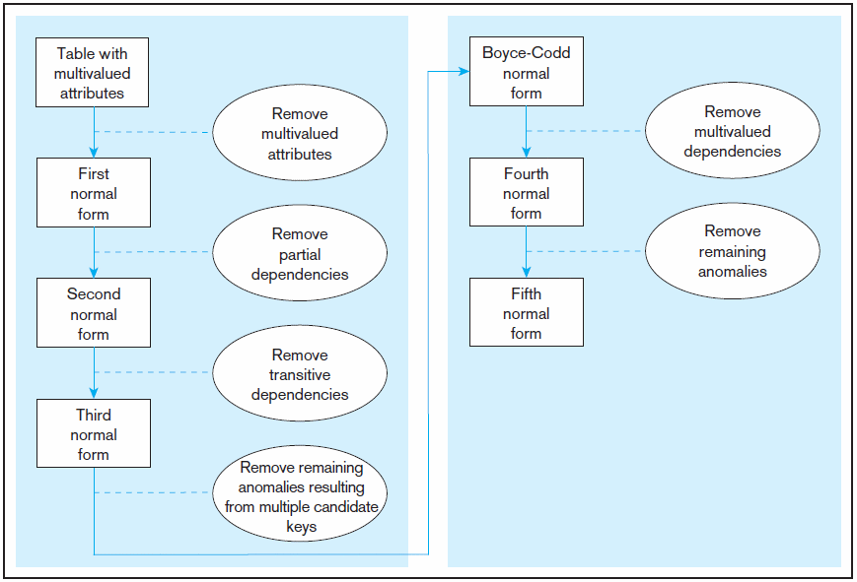
Figure 4.22 Steps in normalization
3rd normal form is generally considered sufficient
© 2011 Pearson Education, Inc. Publishing as Prentice Hall

Slide 62
Data Normalization
Primarily a tool to validate and improve a logical design so that it satisfies certain constraints that avoid unnecessary duplication of data
The process of decomposing relations with anomalies to produce smaller, well-structured relations
© 2011 Pearson Education, Inc. Publishing as Prentice Hall

Slide 63
Well-Structured Relations
A relation that contains minimal data redundancy and allows users to insert, delete, and update rows without causing data inconsistencies
Goal is to avoid anomalies
Insertion Anomaly–adding new rows forces user to create duplicate data
Deletion Anomaly–deleting rows may cause a loss of data that would be needed for other future rows
Modification Anomaly–changing data in a row forces changes to other rows because of duplication
Why do these anomalies exist?
Because there are multiple themes (entity types) in one relation. This results in duplication and an unnecessary dependency between the entities
General rule of thumb: A table should not pertain to more than one entity type
© 2011 Pearson Education, Inc. Publishing as Prentice Hall

Slide 64
First Normal Form
No multivalued attributes
Every attribute value is atomic
© 2011 Pearson Education, Inc. Publishing as Prentice Hall

Slide 65
Second Normal Form
1NF PLUS every non-key attribute is fully functionally dependent on the ENTIRE primary key
Every non-key attribute must be defined by the entire key, not by only part of the key
No partial functional dependencies
© 2011 Pearson Education, Inc. Publishing as Prentice Hall

Slide 66
Third Normal Form
2NF PLUS no transitive dependencies (functional dependencies on non-primary-key attributes)
Note: This is called transitive, because the primary key is a determinant for another attribute, which in turn is a determinant for a third
Solution: Non-key determinant with transitive dependencies go into a new table; non-key determinant becomes primary key in the new table and stays as foreign key in the old table
© 2011 Pearson Education, Inc. Publishing as Prentice Hall

Slide 67
Denormalization
Normalisation
Removes data redundancy
Solves INSERT, UPDATE, and DELETE anomalies
This makes it easier to maintain the information in the database in a consistent state
However
It leads to many tables in the database
Often these need to be joined back together, which is expensive (requires more processing time) to do
So sometimes (not often) it is worth to ‘denormalize’

Slide 68
Denormalization
You might want to denormalise if
Database processing speed are unacceptable (not just a bit slow)
There are going to be very few INSERTs, UPDATEs, or DELETEs
There are going to be lots of SELECTs that involve the joining of tables
Address
Number
Street
City
Postcode
Not normalised since
{Postcode} → {City}
Address1
Number
Street
Postcode
Address2
Postcode
City

Slide 69
Denormalisation
Database Design Goal : creation of normalized relations
Problems of Normalization
Processing speed requirements should also be a goal
If tables decomposed to conform to normalization requirements, the number of database tables expands, which slows down processing.
Joining larger number of tables takes additional disk input/output (I/O) operations and processing logic (especially dealing with SQL) and reduces system speed
Conflicts (Speed Vs Normalization)
Conflicts among design efficiency, information requirements, and processing speed are often resolved through compromises that may include denormalization.

Slide 70
Summary
Normalization is a process of optimizing databases to prevent update anomalies
Normalization attempts to correct update issues by eliminating duplication
Duplication also creates inconsistency
Insertions can violate database integrity if the database is not normalized
Deletions can violate database integrity if the database is not normalized

Slide 71
Summary (con’t.)
Normal Forms – First (1NF), Second (2NF), Third(3NF)
1NF has no repeating groups
2NF is in 1NF and no non-key column is dependent on only a portion of the primary key
Every non-key attribute must be dependent on the ENTIRE primary key
3NF is in 2NF and the no transitive dependency
There are no “relationship” between the non-key attributes

Slide 72
Summary
Normalization is a table design technique aimed at minimizing data redundancies.
First three normal forms (1NF, 2NF, and 3NF) are most commonly encountered.
Tables are sometimes denormalized to yield less I/O which increases processing speed.

